Slide 1
Memory …..
Measuring and improving cache performance

Slide 2
Misses and Associativity in Caches
Assume there are three small caches:
each consisting of four one-word blocks.
One cache is fully associative,
a second is two-way set-associative,
and the third is direct-mapped.
Find the number of misses for each cache organization given the following sequence of block addresses: 0, 8, 0, 6, and 8.

Slide 3
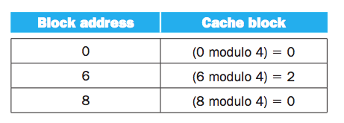
Direct Map

Slide 4
Direct Map
Address of memory block accessed | Hit or miss | 0 | 1 | 2 | 3

Slide 5
Direct Map
Address of memory block accessed | Hit or miss | 0 | 1 | 2 | 3
0 | miss | Memory[0]

Slide 6
Direct Map
Address of memory block accessed | Hit or miss | 0 | 1 | 2 | 3
0 | miss | Memory[0]
8 | miss | Memory[8]

Slide 7
Direct Map
Address of memory block accessed | Hit or miss | 0 | 1 | 2 | 3
0 | miss | Memory[0]
8 | miss | Memory[8]
0 | miss | Memory[0]

Slide 8
Direct Map
Address of memory block accessed | Hit or miss | 0 | 1 | 2 | 3
0 | miss | Memory[0]
8 | miss | Memory[8]
0 | miss | Memory[0]
6 | miss | Memory[0] |  | Memory[6]

Slide 9
Direct Map
Address of memory block accessed | Hit or miss | 0 | 1 | 2 | 3
0 | miss | Memory[0]
8 | miss | Memory[8]
0 | miss | Memory[0]
6 | miss | Memory[0] |  | Memory[6]
8 | miss | Memory[8] |  | Memory[6]

Slide 10
Direct Map
Address of memory block accessed | Hit or miss | 0 | 1 | 2 | 3
0 | miss | Memory[0]
8 | miss | Memory[8]
0 | miss | Memory[0]
6 | miss | Memory[0] |  | Memory[6]
8 | miss | Memory[8] |  | Memory[6]

Slide 11
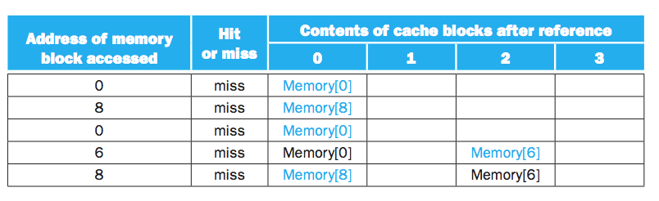
Direct Map …..

Slide 12
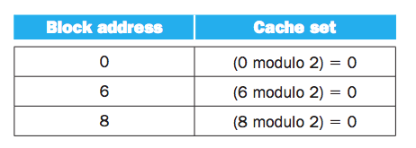
Set Associative

Slide 13
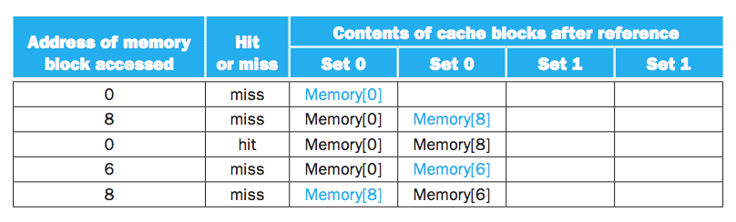
Set Associative…….

Slide 14
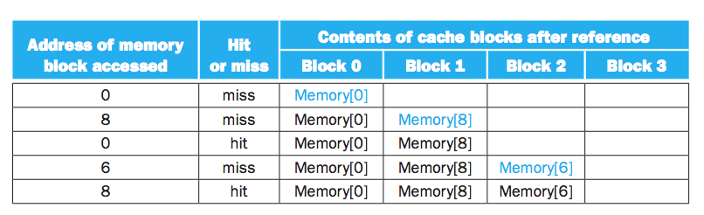
Fully Associative

Slide 15
cache size and associativity are dependent
Eight Blocks in the cache
two-way set associative will have no replacement
16 blocks in the cache
All will have same number of misses

Slide 16
Locating a Block in the Cache
Set Associative
Tag -> to identify the block
Index -> identify the set
Block offset -> address of the desired data block
Search has been done in parallel
Sequential search will increase the hit time
Make the set-associative cache too slow

Slide 17
Fixed cache size: increasing associativity effect
increasing the associativity => increases the
number of blocks per set
Each increase by a factor of 2 in associativity
doubles the number of blocks per set and
halves the number of sets.
decreases the size of the index by 1 bit and
increases the size of the tag by 1 bit.

Slide 18
Fully Associative
What is the size of the tag and index?
No index
All bits except data address offset (index+tag)

Slide 19
Direct Map
How many comparator needed?
Only one

Slide 20
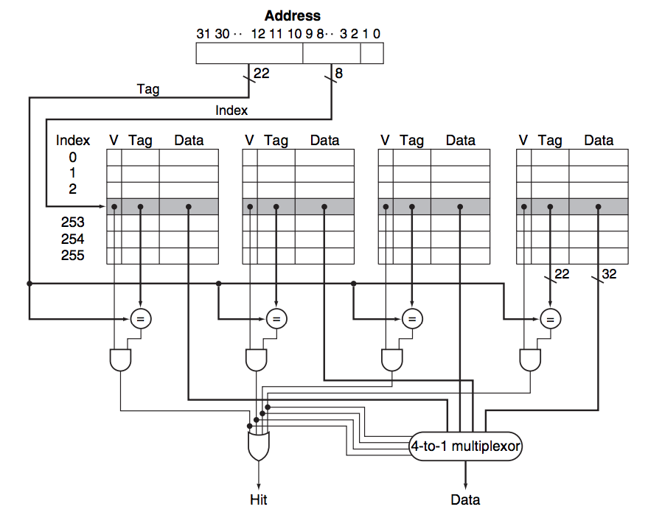
4-way Set-Associative

Slide 21
What to Chose?
Set Associative or Direct Mapping
Cost of missing vs
Cost of associativity implementation

Slide 22
Choosing Which Block to Replace
Direct map -> only one location
Associative (Set Associative)
We have freedom (after selecting the set)
LRU (least recently used)
Unused for a longer time
Requires to implement a tracking technique
2-way we can use single bit (0/1)
Increase in block size make implementation harder

Slide 23
Reducing the Miss Penalty Using Multilevel Caches
Keep memory access time low with the increase of processor.
Multilevel Cache hierarchy
Primary cache
Secondary cache
Main memory
Is there is hit, it is faster
In case of miss penalty is more

Slide 24
Software Optimization via Blocking
Memory Hierarchy/access is an important factor to program performance
Software optimization => Dramatic increase in performance
Reusing data in the cache
Lower miss rate
Improve temporal locality

Slide 25
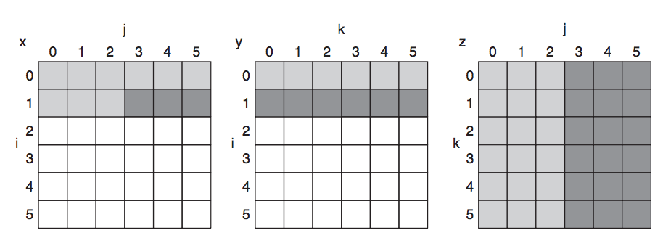
Sample Example: Matrix Multiplication

Slide 26
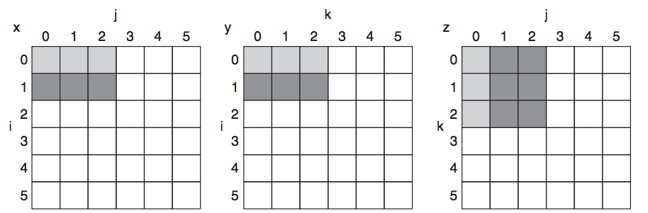
Blocked DGEMM

Slide 27
What we have covered?
Section 5.4

